Slide 1



vFlashCards_____________
Flashcards at your fingertip.
Study aids on the go.
CISC 4900 Brooklyn College - City University of New York
Professor K. Chuang, Professor AJ Lapid
Project Developer: Min-Chun Lo
Supervisor:
Professor Edgardo Molina

Slide 2
What & Why?
Full stack web application virtual flashcards.
Built on PostgreSQL, Express, React, Node.js.
Convenience of study aids for students on the go.
Because everything can be organized in one place.
Not easily misplaced.

Slide 3
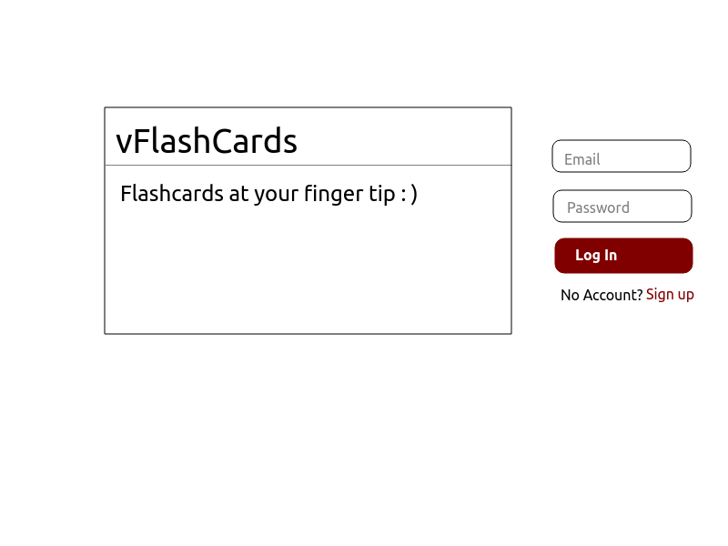
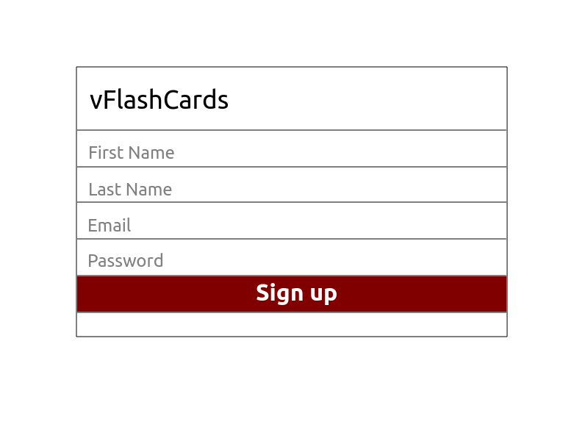
UI/Mockup
Home / Landing page
Signup

Slide 4
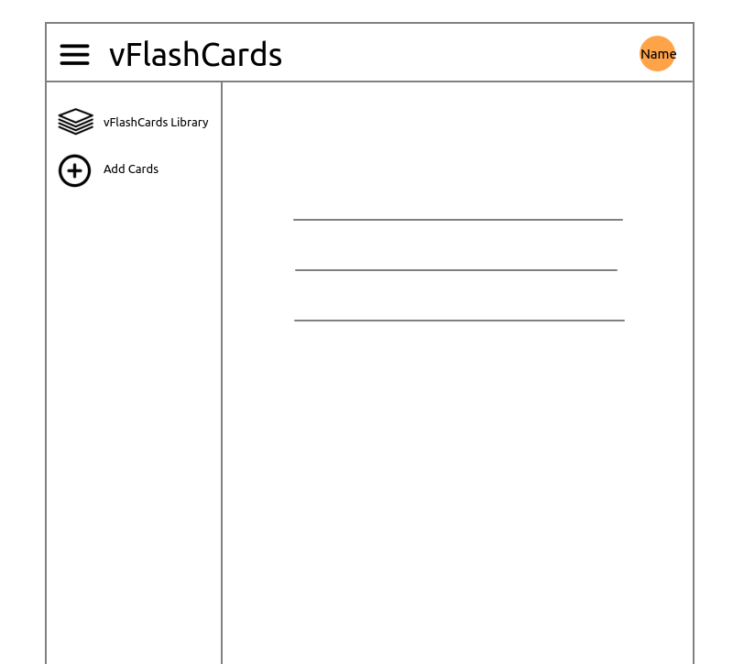
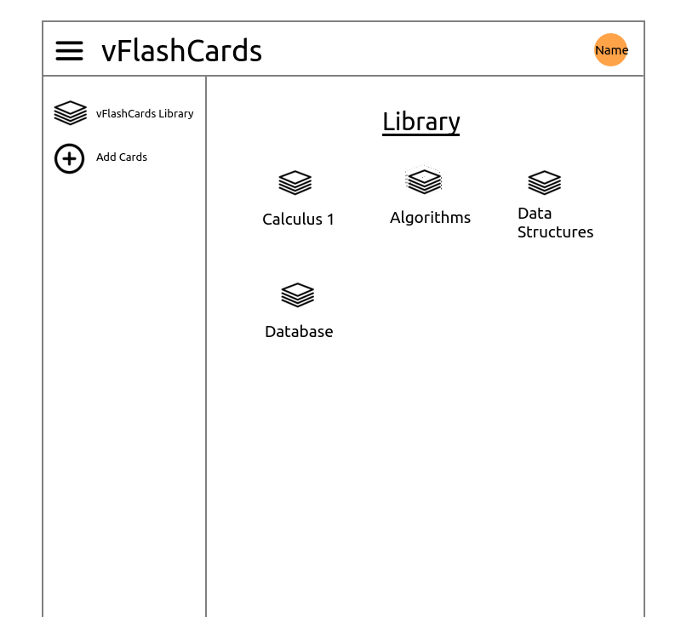
UI/Mockup
Profile
Library

Slide 5
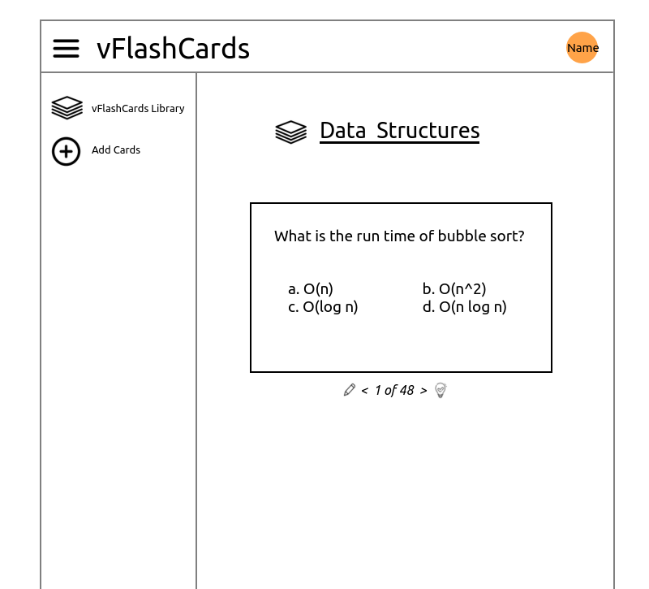
UI/Mockup
Flashcard

Slide 6
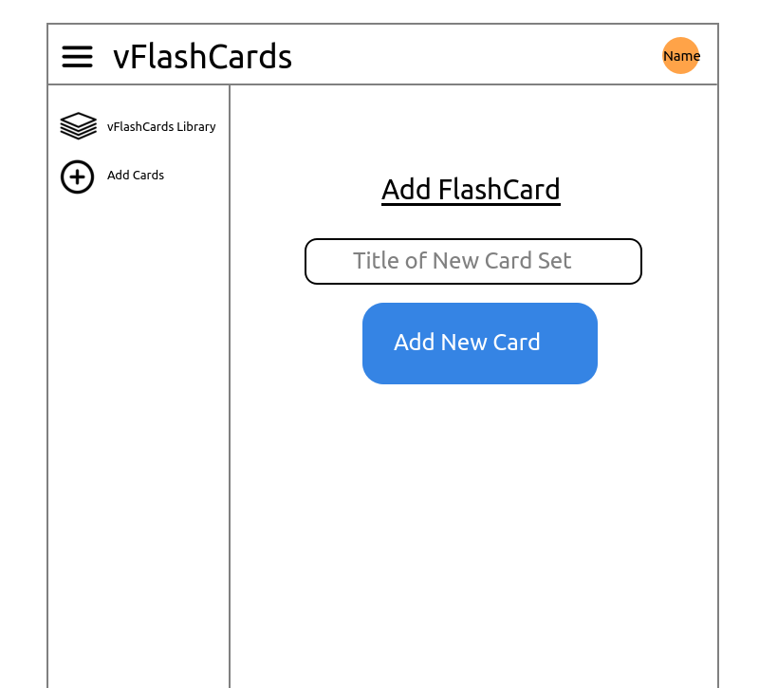
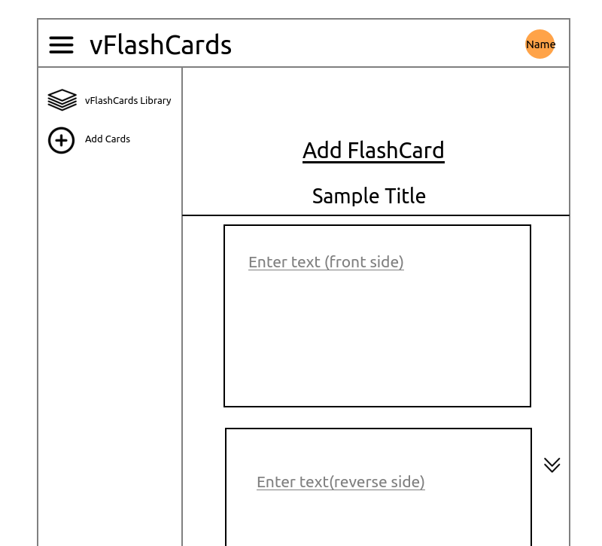
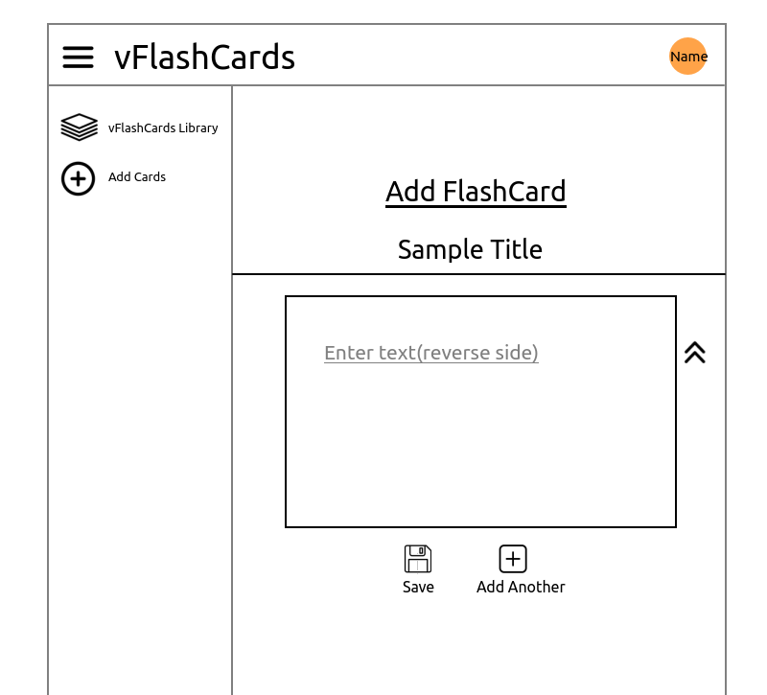
UI/Mockup
Add card set
Add question
Add answer and save
Note: Mockup created on KolourPaint (Linux). Not recommended as a first choice. Google Drawings can be a good choice due to its low learning curve and features. Frontend to be built before the end of the semester.

Slide 7
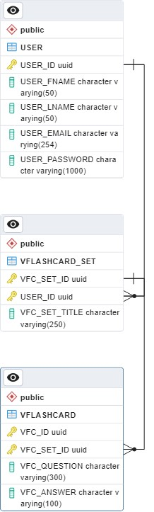
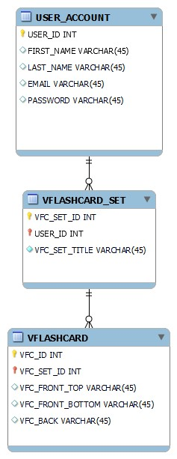
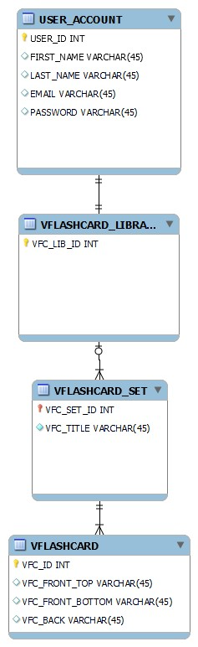
Behind the Scenes Backend
Database ERD
Recreated ERD with pgAdmin. Amended the column name and data type.
First ERD, which showed how I went about structuring the data.
Deleted redundant table as per recommendation from Edgardo Molina
Generated script (via pgAdmin) required double quotes for all tables, which was unexpected..
Deleted all existing tables and recreated them scratch.
The database schema from inception, which went through iterations to arrive at the current one as seen on the next page. Also, generated scripts may not result in expected result. In the above, tables needed to be double quoted for SQL query.

Slide 8
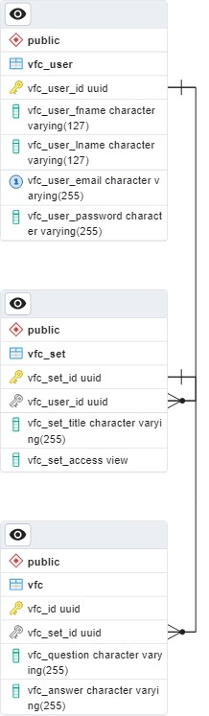
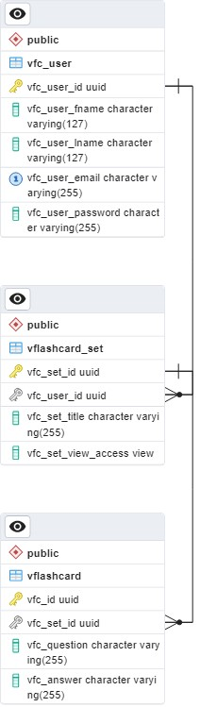
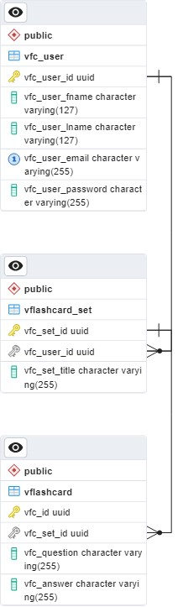
Behind the Scenes Backend
Database ERD
Added additional attribute under vflashcard_set for view access.
Shorten table names for convenience.
(Less typing during coding & debugging processes.)
Updated the primary key to using a single attribute instead of two.
Done as a workaround for failed attempts to create the third table, vflashcard.
Implemented an ENUM type (public/private) as suggested by Edgardo Molina.
Note: ER diagrams were created using MySQL WorkBench (first two ERD) and pgAdmin from PostgreSQL. Both are available from the official website at no cost as of 2023-12.

Slide 9
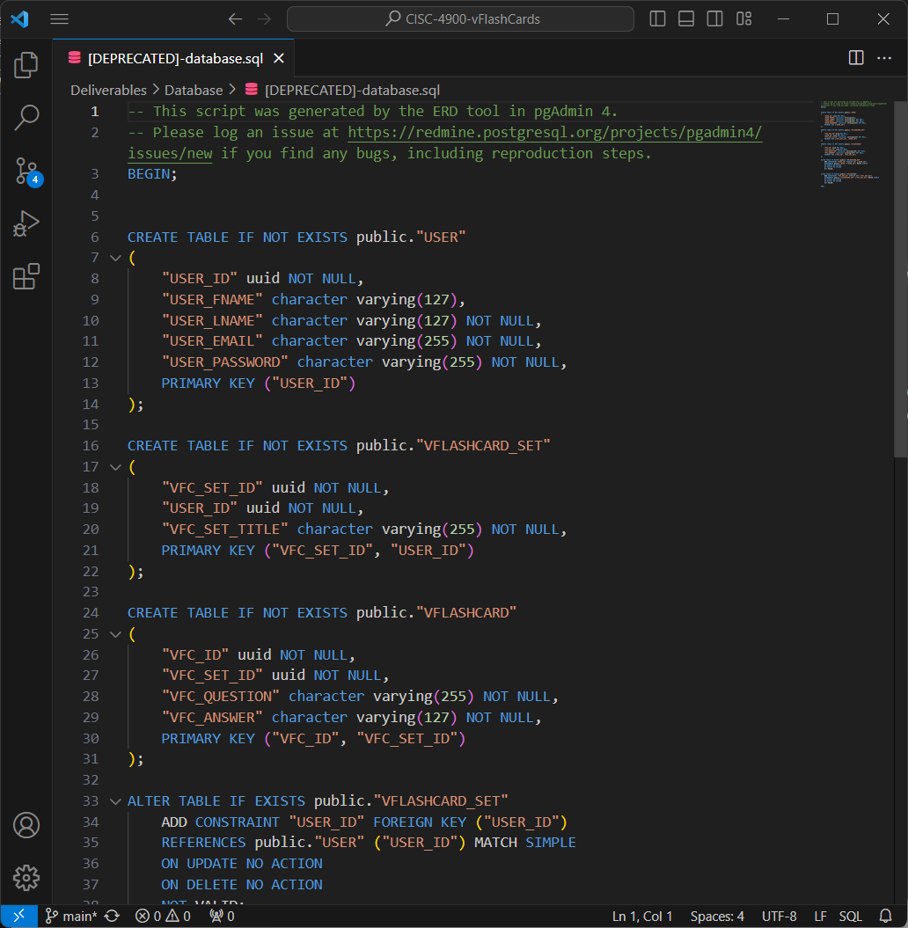
Behind the Scenes Backend
SQL Query Journal
Initial attempt to generate a database based off the ER diagram produced by pgAdmin. (See right screenshot.)
Auto-generated script did not yield in the expected result, which included tables and attributes requiring double quotation marks during SQL queries.
Queries have to be written to delete and recreate tables.

Slide 10
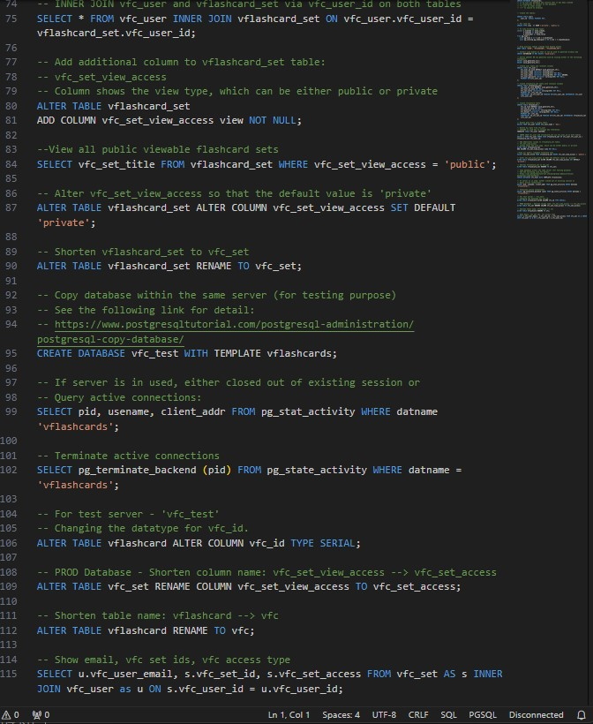
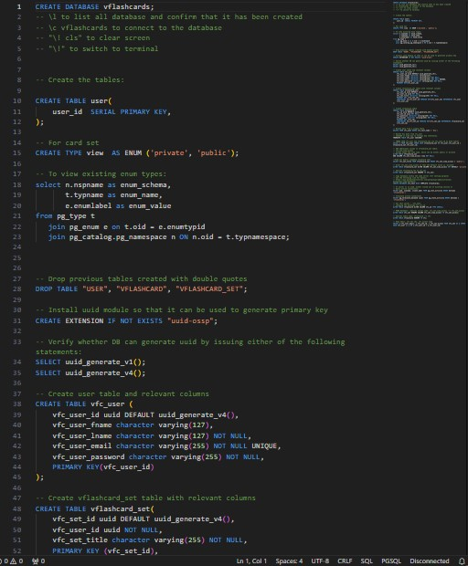
Behind the Scenes Backend
SQL Query Journal
List of queries used during the project.
Note: Producing a journal takes time, but is helpful for record keeping. It also allows for quick references on previously used queries and can serve as a reminder as to why particular decisions took place.

Slide 11
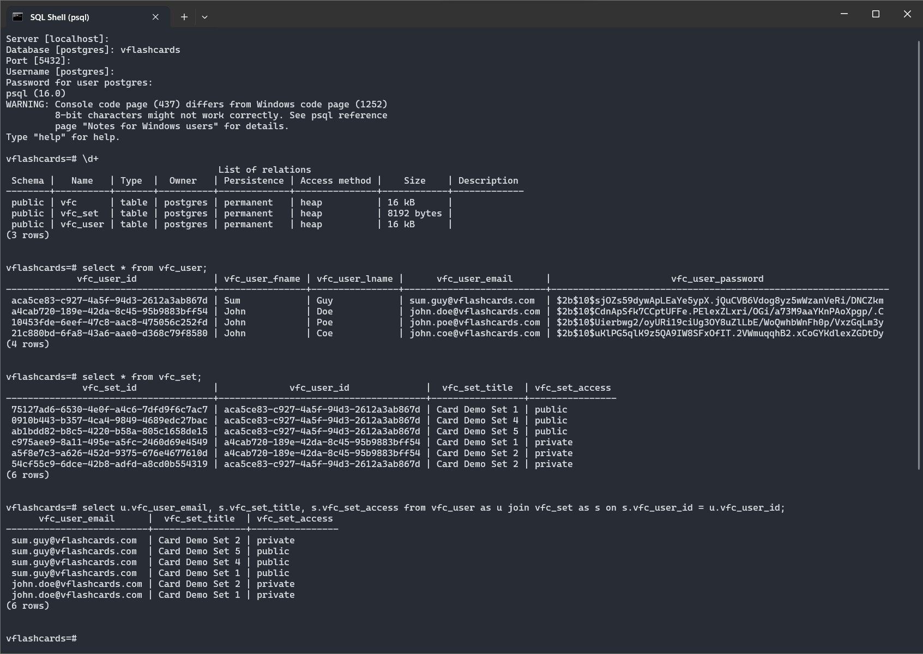
Behind the Scenes Backend
PostgreSQL Database
List of relations / tables
Querying user list & card sets.
Joining tables to get users who have card sets, which list email, associated card sets, and the access type.

Slide 12
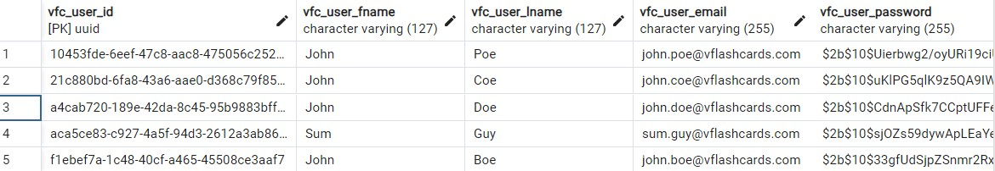
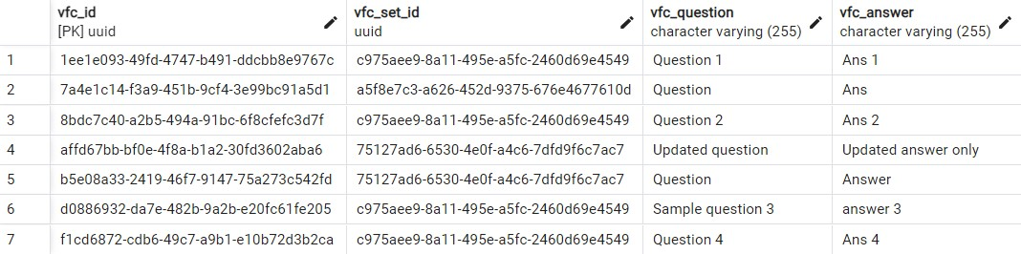
Behind the Scenes Backend
PostgreSQL Database (via pgAdmin 4)

Slide 13
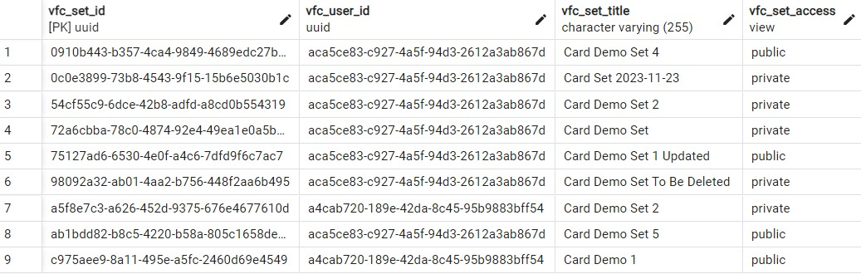
Behind the Scenes Backend
PostgreSQL Database (via pgAdmin 4)

Slide 14
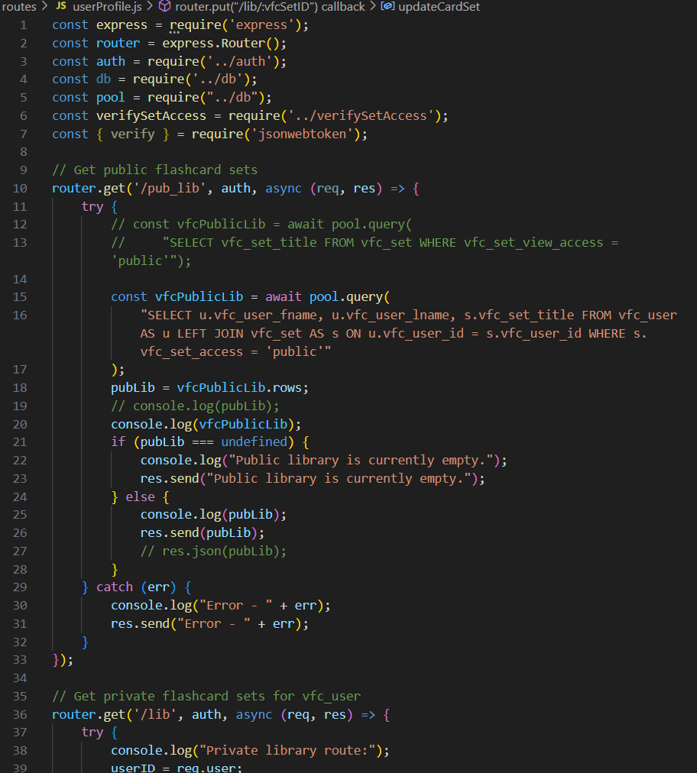
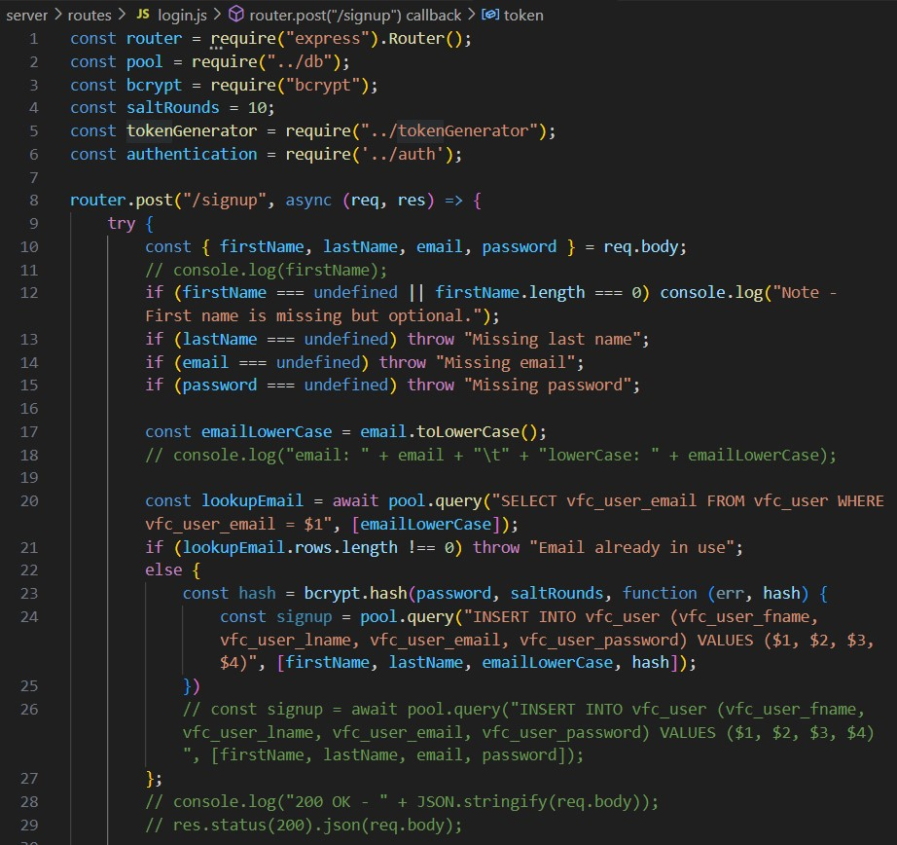
Behind the Scenes Backend
Routes
Login & User Profile
(Using Express & Node.js)
Routes for sign-up and login.
To retrieve sets of flash cards, update/delete cards

Slide 15
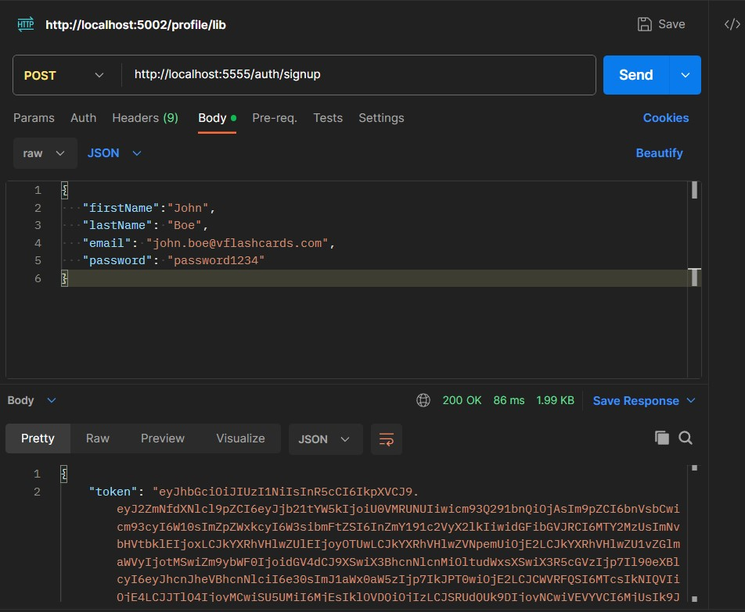
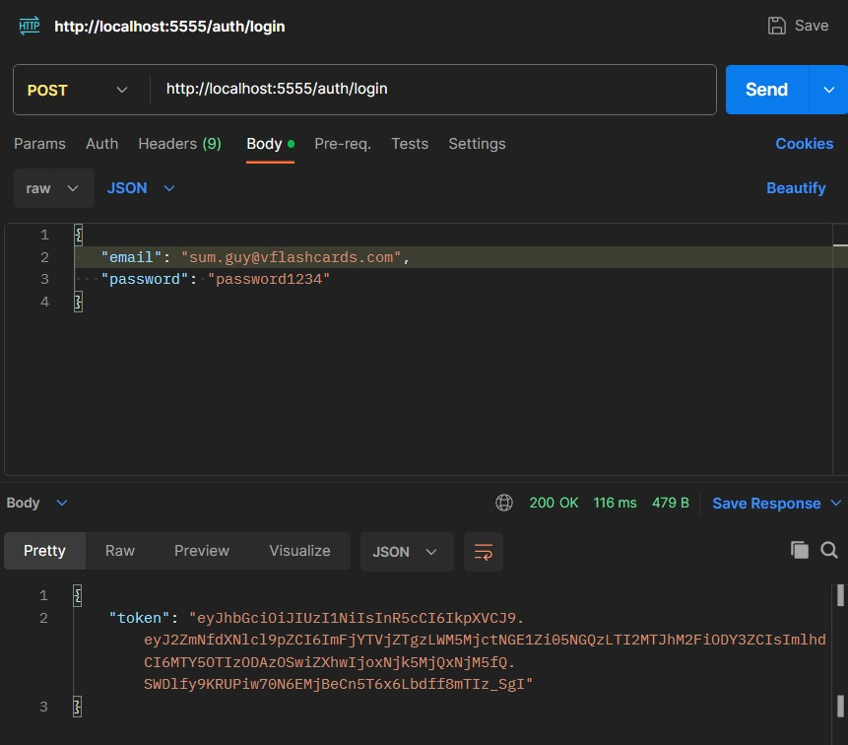
Behind the Scenes Backend
Routes
API Request & Response With Postman
Sign up process for John Boe.
Login authentication for Sum Guy.

Slide 16
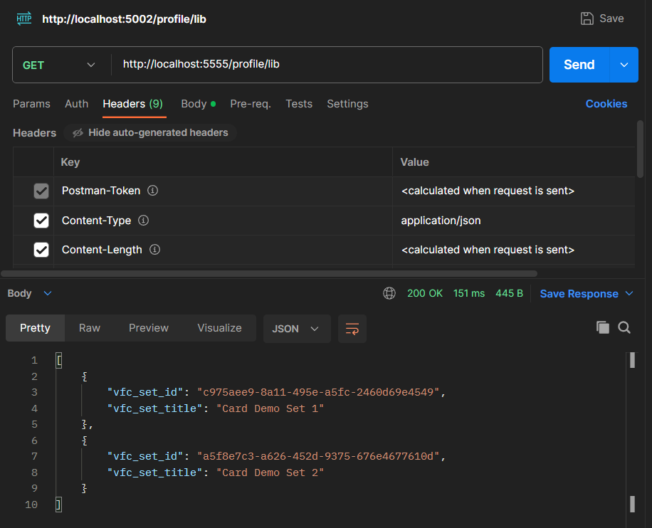
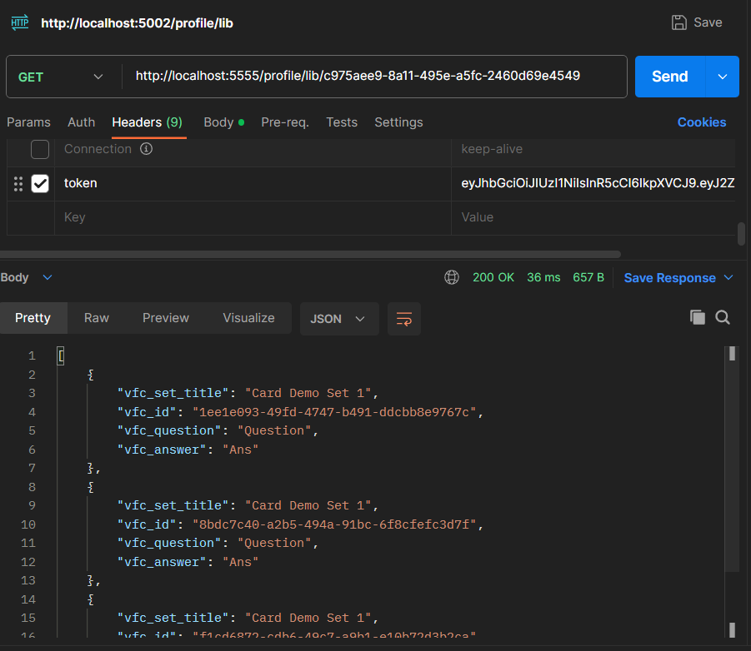
Behind the Scenes Backend
Routes
API Request & Response With Postman
Getting the library set of cards.
Then a list of cards from a set.

Slide 17
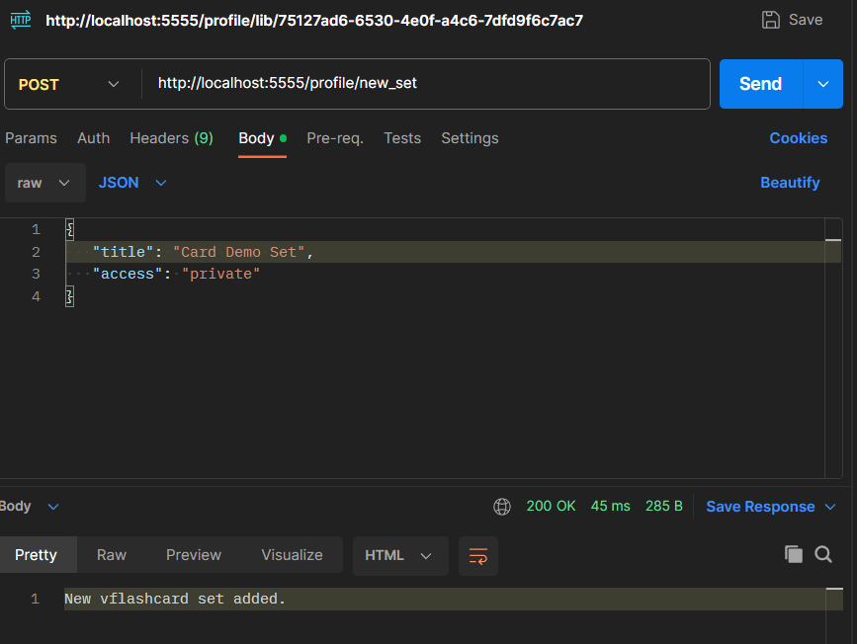
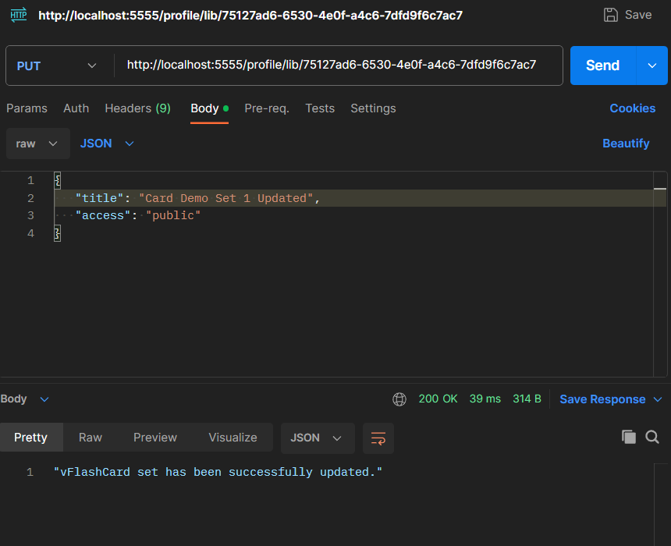
Behind the Scenes Backend
Routes
API Request & Response With Postman
Create a new card set.
Update title and access for a card set.

Slide 18
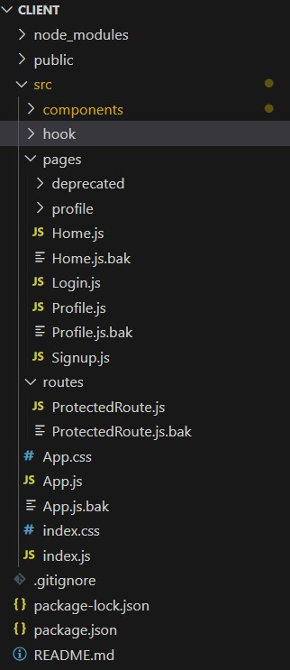
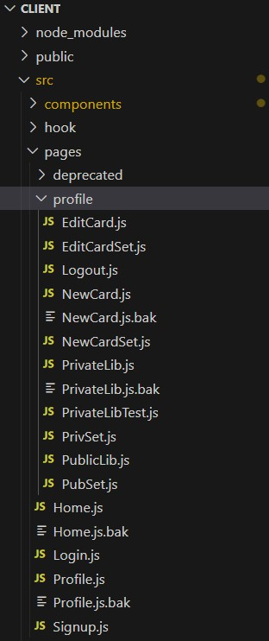
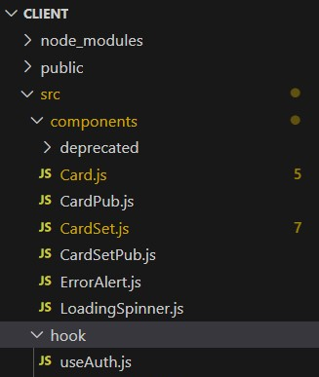
vFlashCards
(in action)
(in action)
./pages & ./routes
./pages/profile
./components/ &
./hooks
A quick look at frontend and the directory structure:

Slide 19
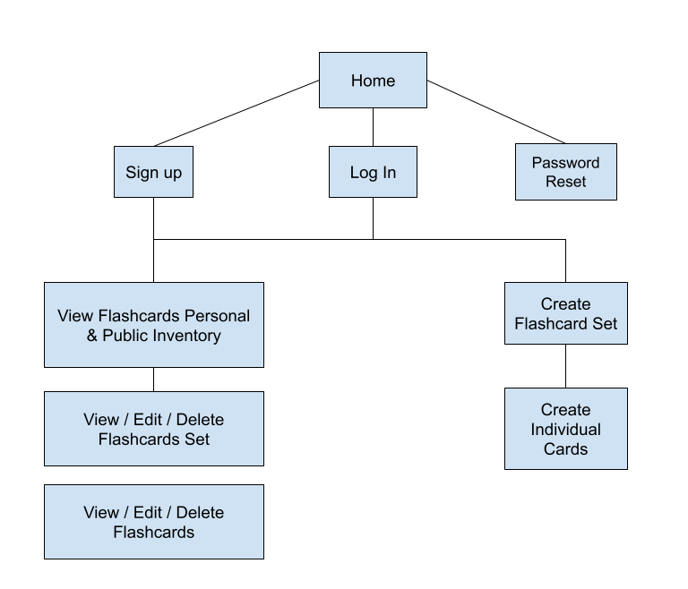
Site Map
Wrap Up
Wrap Up

Slide 20
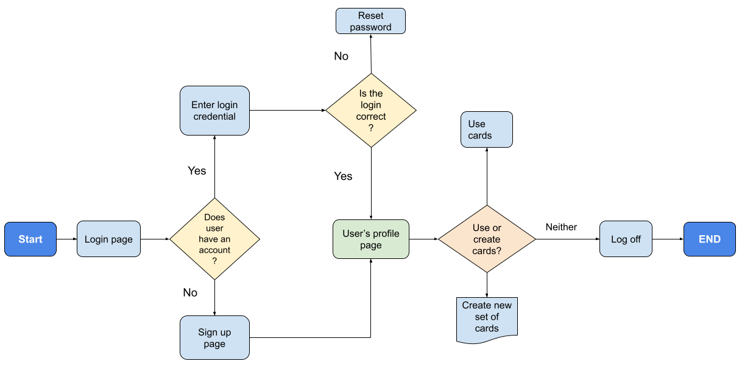
User Flow Chart
Wrap Up
Wrap Up

Slide 21
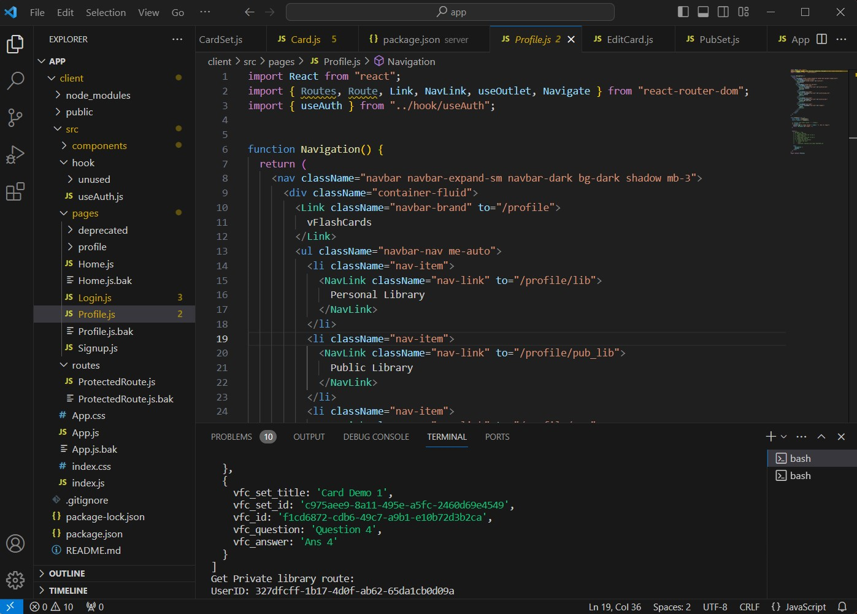
vFlashCards
(in action)
(in action)
Quick view of the work environment.

Slide 22
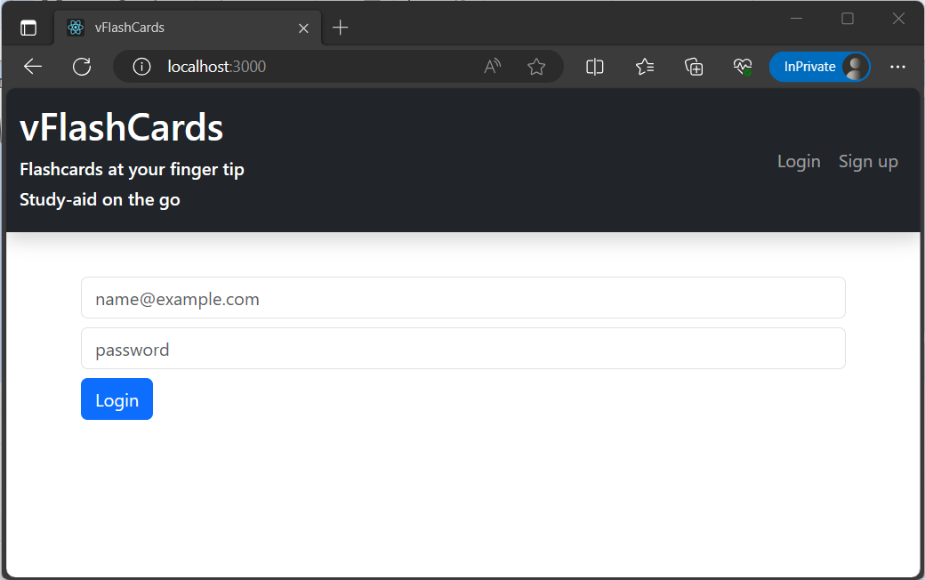
vFlashCards
(in action)
(in action)
Landing Page

Slide 23
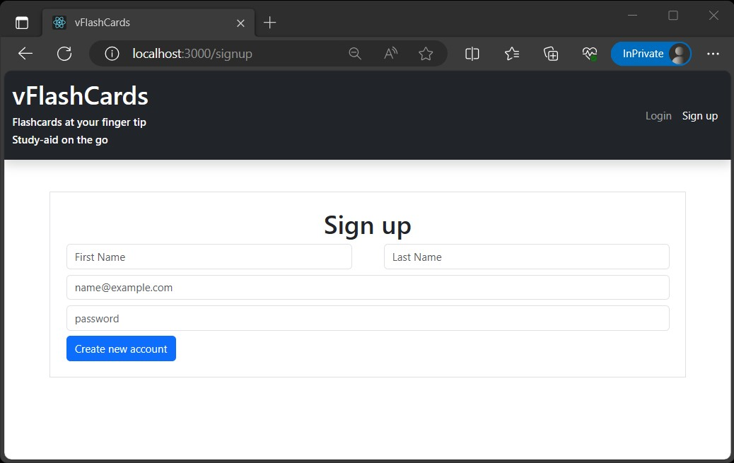
vFlashCards
(in action)
(in action)
Sign up

Slide 24
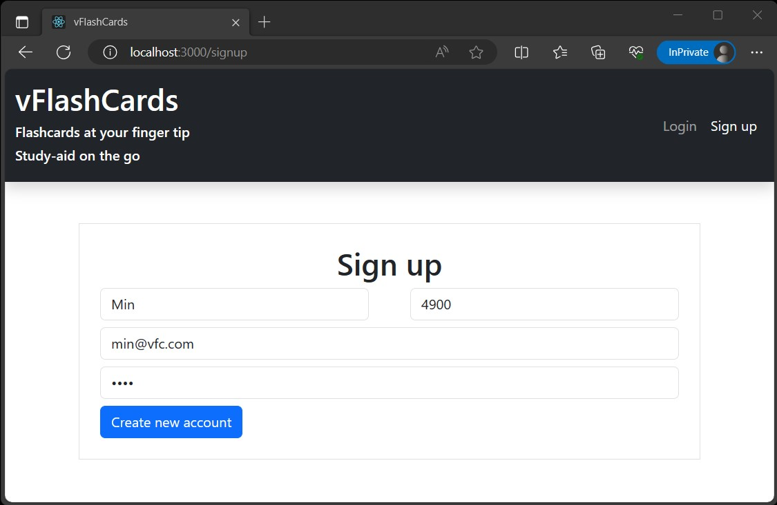
vFlashCards
(in action)
(in action)
Enter information to create account

Slide 25
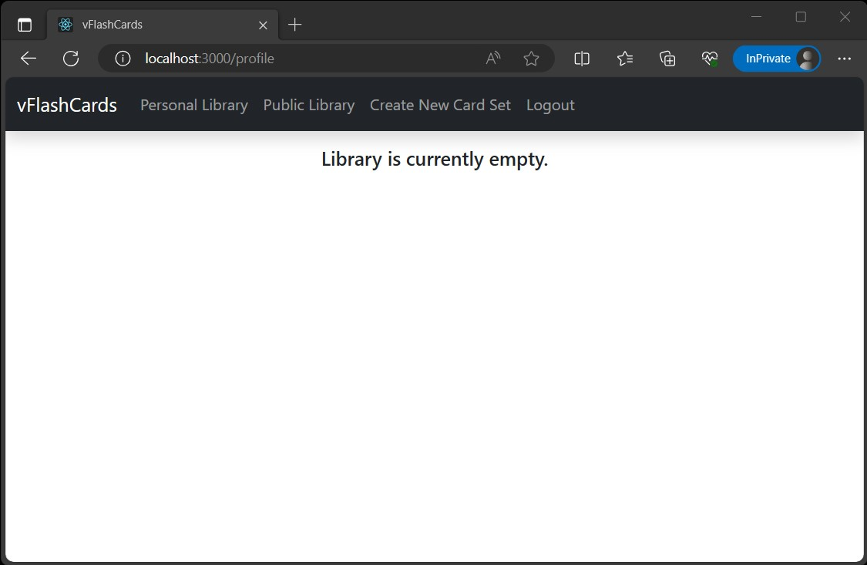
vFlashCards
(in action)
(in action)
Newly created profile! Personal library is empty, though…

Slide 26
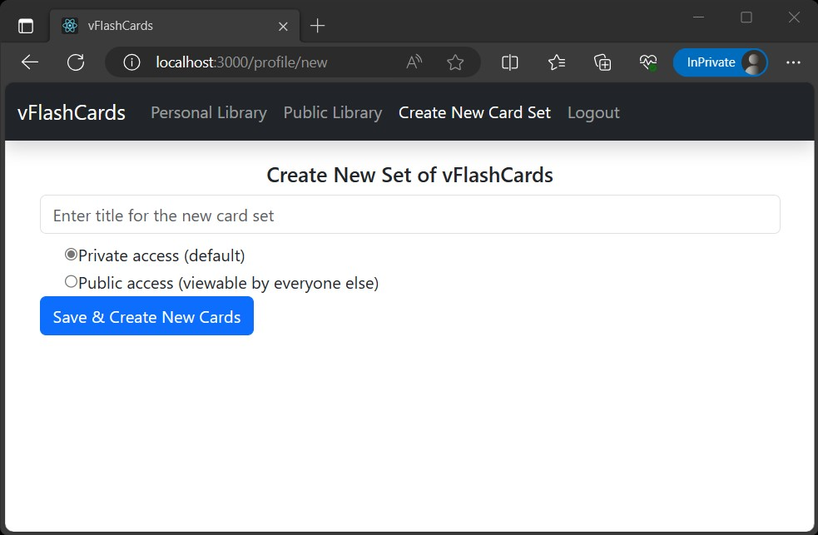
vFlashCards
(in action)
(in action)
Create new card set. Enter title and select access type.

Slide 27
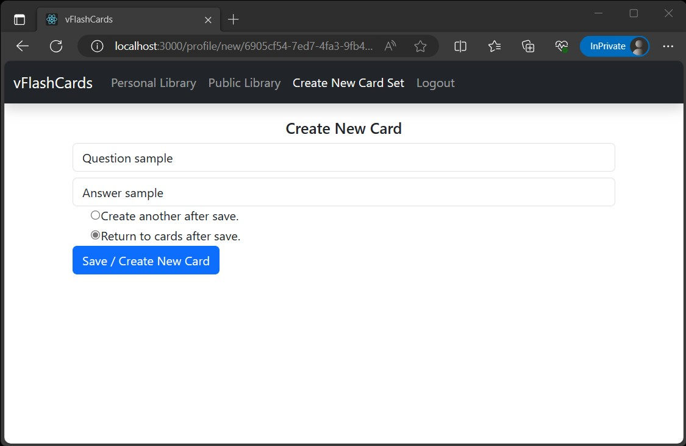
vFlashCards
(in action)
(in action)
Enter question and answer. Let’s save and return to view the existing card.

Slide 28
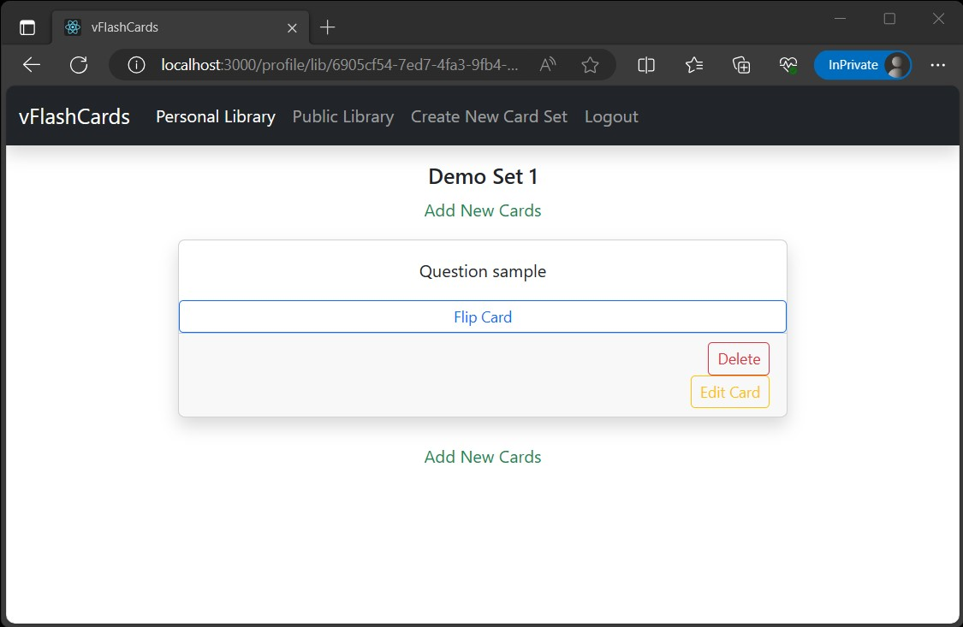
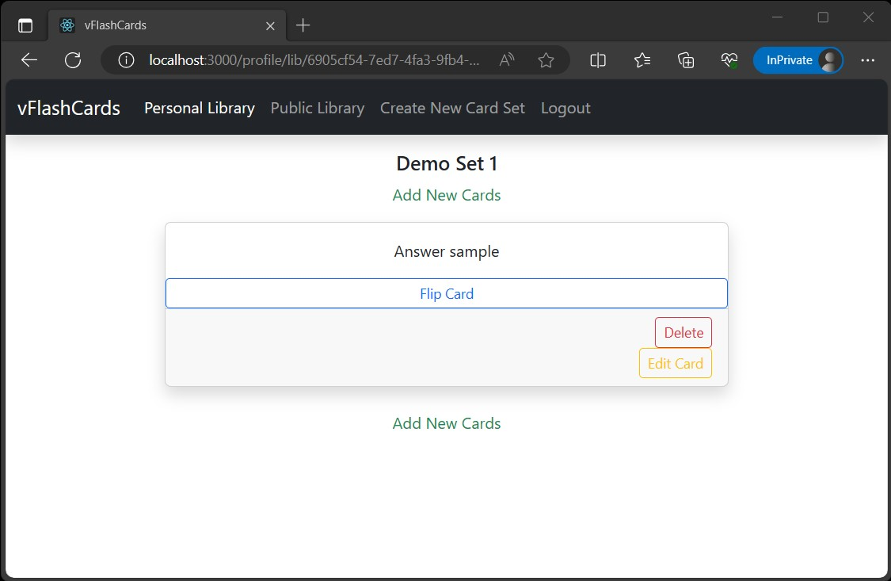
vFlashCards
(in action)
(in action)
We have a new card in our Demo Set card set! Noticed that the answer is viewable by flipping the card.

Slide 29
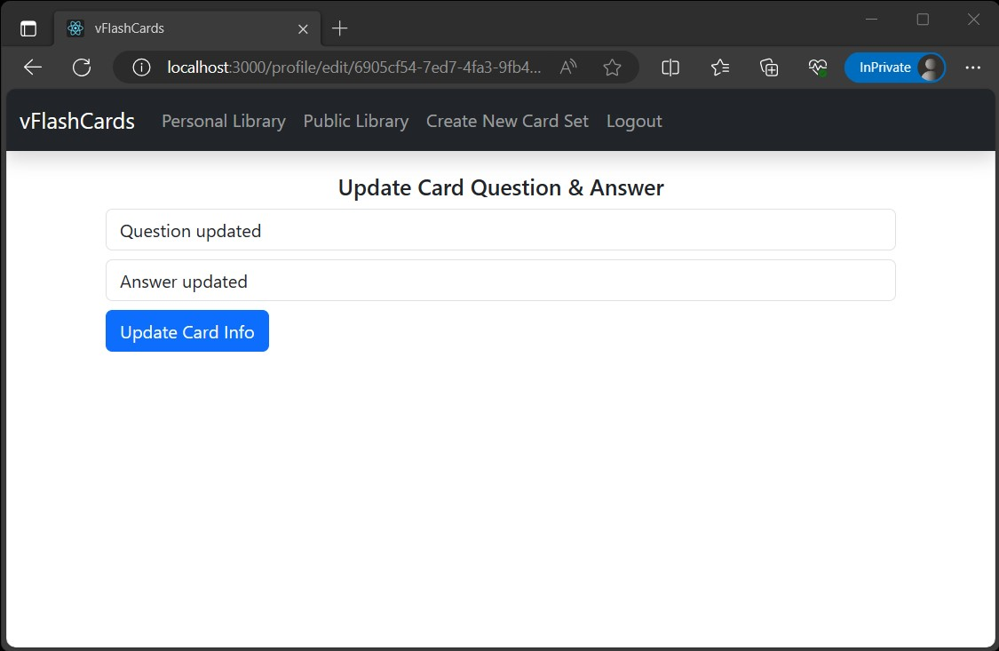
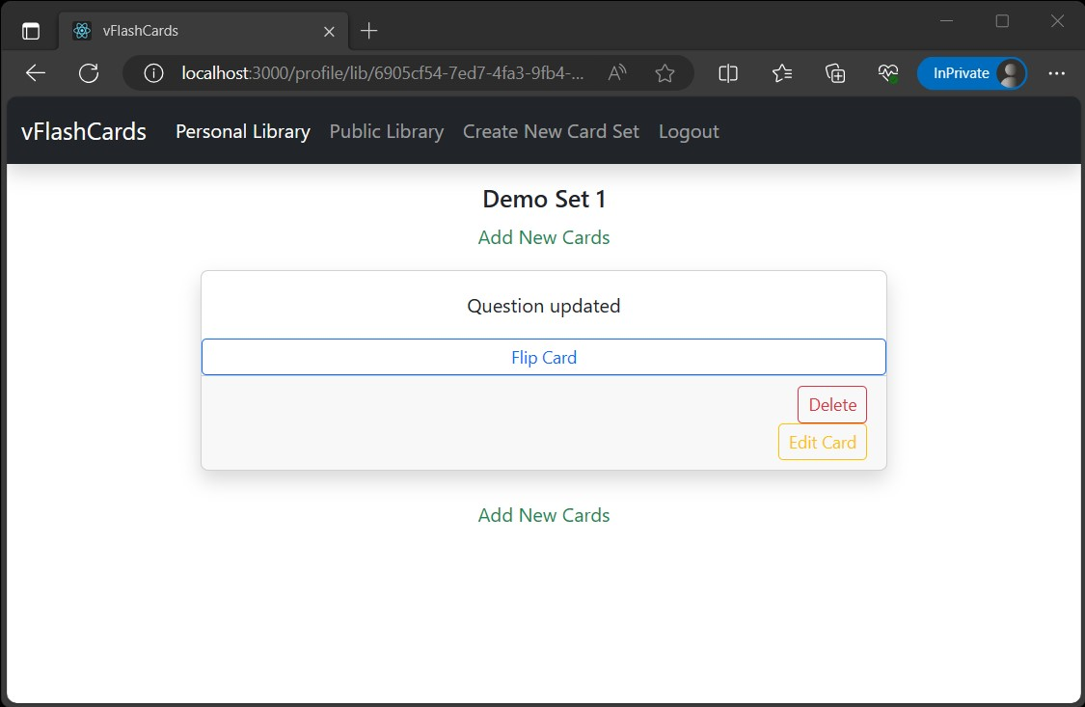
vFlashCards
(in action)
(in action)
By editing the existing question, the card can be revised. Note the updated question.

Slide 30
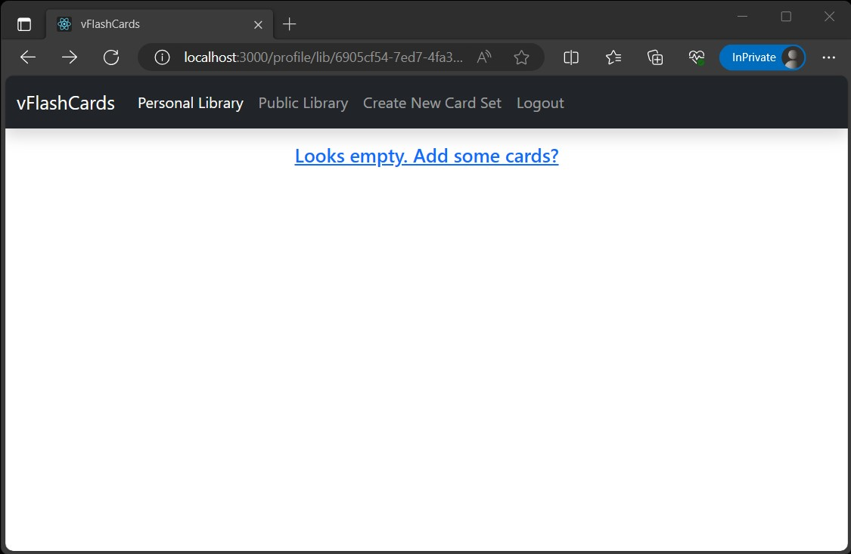
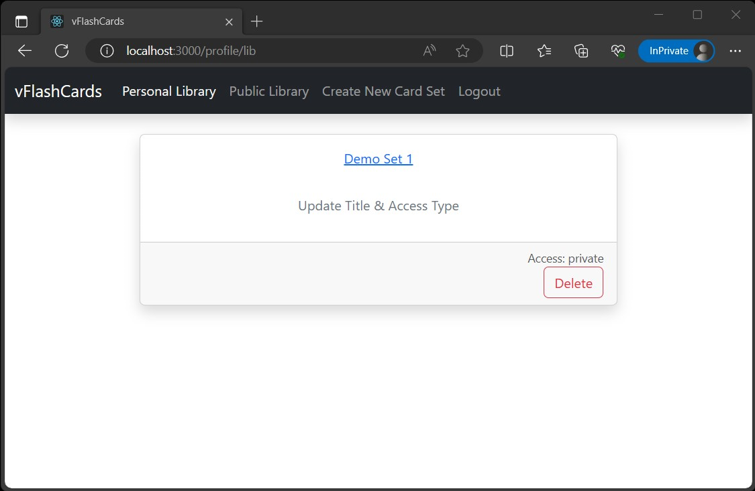
vFlashCards
(in action)
(in action)
Cards can be deleted also. After deleting the only card, the set is now empty. Note that the library still has a card set. If you delete it…

Slide 31

vFlashCards
(in action)
(in action)
Now the library has been emptied.

Slide 32
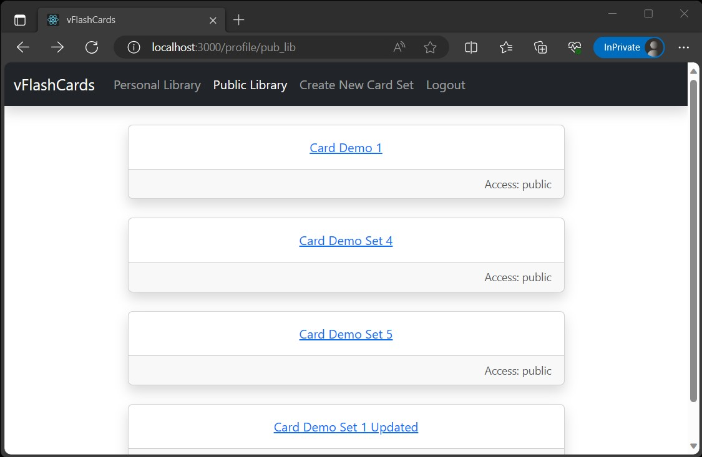
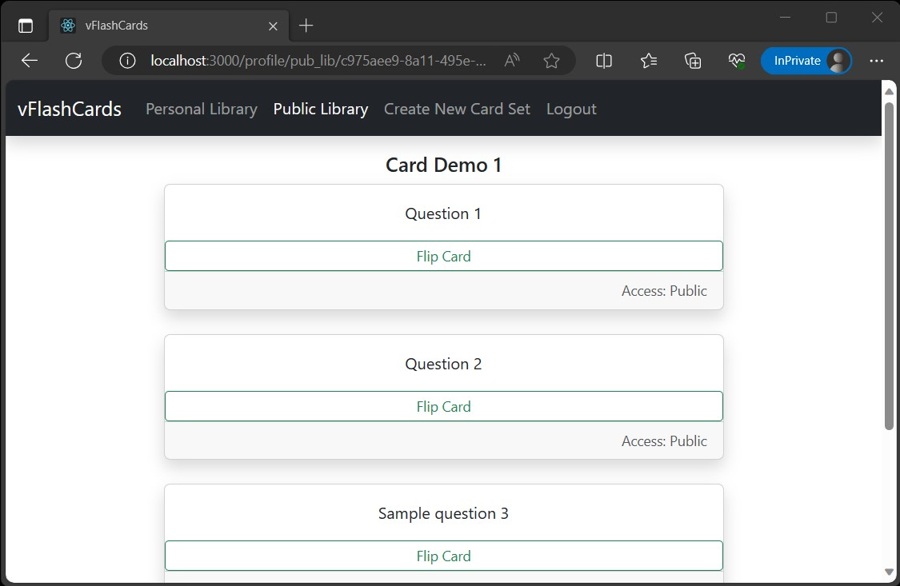
vFlashCards
(in action)
(in action)
Well, there is the public library, which consists of other shared card sets!

Slide 33
Challenges
Learning
PERN stack
API requests and responses
Bcrypt (for salt & hashing password)
Routing on the backend
JSONWebToken (and learning about the security downsides and alternative from Professor Molina)
React Router on frontend
Deployment of the app
Testing & debugging
JSONWebToken, which include implementation and security implications.
React Router.
Deployment to Render
Database
Augment existing knowledge from previous database course. This includes PostgresSQL setup, database implementation, expanding knowledge on SQL queries, and figuring out the appropriate data type.

Slide 34
Challenges
Working solo
Responsible for all aspects from ideation, planning, designing, coding, debugging, writing documentation, and understanding all technical concepts.
Mundane tasks can take significantly more time than expected.
Laptop issue
Primary laptop had to be serviced offsite for close to a month.
Backup laptop is unreliable and prone to crash. (On either Windows or Linux. Hardware diagnostics did not uncover any issue.)
Had to setup, backup, and configure environments on separate machines.

Slide 35
Thanks
Despite working solo, this is not truly a solo project, per se. Assistance and guidance were given at different junctures to push the project ahead. Without these individuals, the project would not have arrived at its current state. A word of thanks to:
Woodley Gelin for perspective on the class and web application projects.
Professor Lapid for spending time to discuss, guide, and provide ideas for the project and deliverables.
Akbar Mirza, my CUNYTechPrep TA, for his technical guidance.
Professor Edgardo Molina, for the patience, generosity of knowledge, and time given to advise and guide my project to completion.

Slide 36
Project Repository
Wrap Up
Wrap Up
vFlashCards App: https://vflashcards.onrender.com/
GitHub Repo: https://github.com/not-x/vFlashCards
Time Log: https://github.com/not-x/vFlashCards/blob/main/Time_Log.csv
Project Management Board: https://github.com/users/not-x/projects/1

